Slide 1
Programming for Graphics
Geometry (Indices, meshes and objects)

Slide 2
Geometry and 3d models

Slide 3
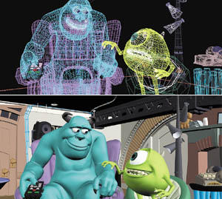
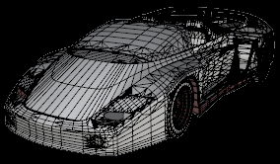
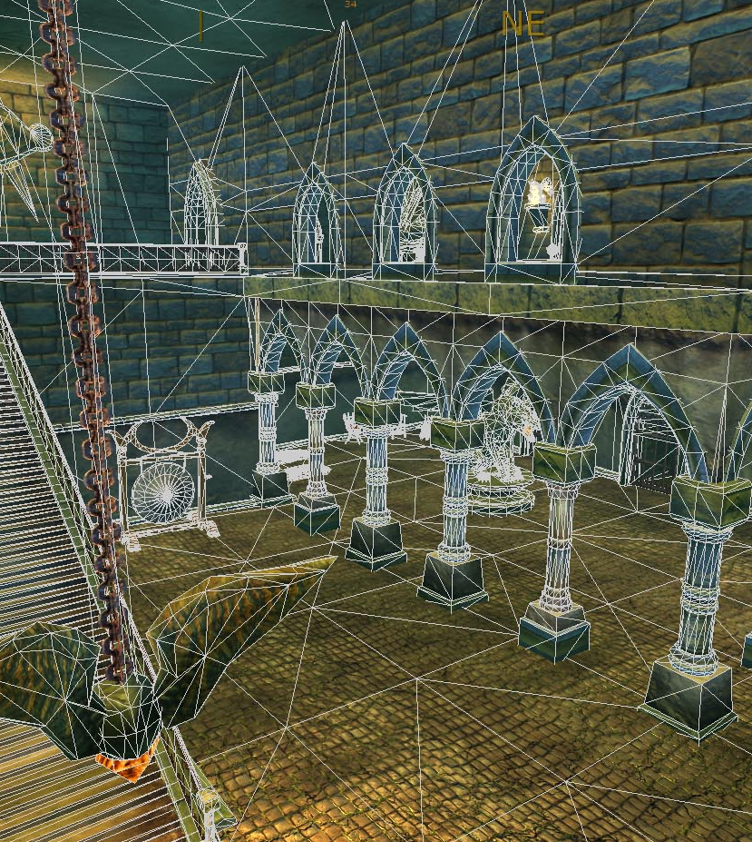
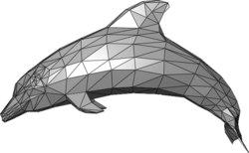
How do we represent complex geometry?

Slide 4

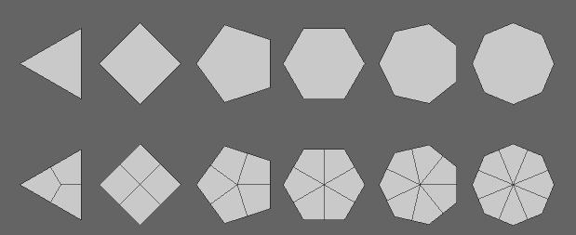
Triangles!
Its almost always triangles
Some hardware can support quads and other primitives but most of the time its triangles.
Even in 3DS max. 3DS just hides it from you.

Slide 5
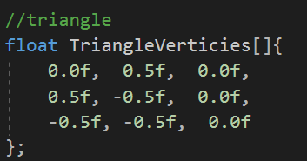
Representing triangles in computers
You’ve seen it before.
Its our array of floats with 3 sets for 3 floating point numbers.
One point off to the top / centre
And 2 points below centre, on left and right of centre

Slide 6
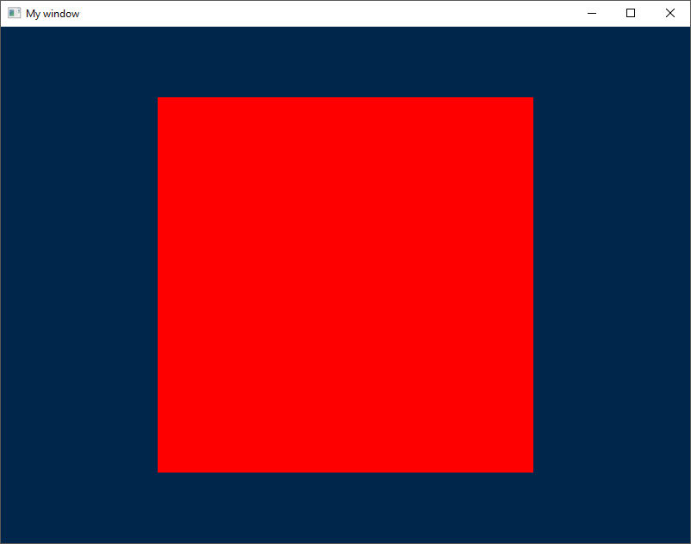
More complicated
Even squares are just 2 triangles.
Why do we use triangle?
All primitives can be divided in to triangles, but triangles can not be divided in to anything else. Its is the simplest primitive you can make with points and lines and you cant bend them.
Tringles are defined as having 3 points, connected by 3 straight lines.
Notes:
Try it you self.
Get a piece of paper, make it in to a triangle (I don’t care how) and try to make a new shape, or bend it while keeping exactly 3 points and all 3 lines straight.
If you manages to do this HOW!!!!!???? Otherwise, told you.

Slide 7
Even Complicated polygons can be split

Slide 8
GL_TRIANGLES
For every 3 points in our vertex array, draw a triangle
GL_TRIANGLE_STRIP
Uses less memory than GL_TRIANGLES (unless we using indices).
Uses last 2 elements of previous triangle to make next triangle. (assumes all triangles are connected. (ABC, BCD, CDE)
GL_TRIANGLE_ FAN
Triangles are organised in a fan shape around the centre (usually the first vertex point)
B
D
E
C
A
B
F
C
A
E
D

Slide 9
Indices

Slide 10
Squares
Lets move on from triangles and make a square!

Slide 11
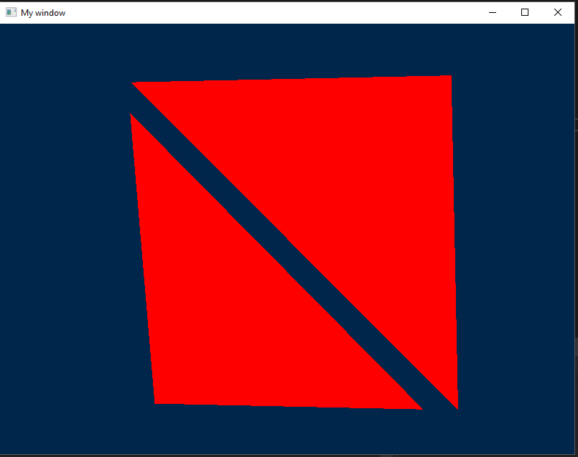
As we discussed in previous slides, squares are just to triangles.
so we need 6 points right?
No, we can reuse 2 of the points from the first triangle.
We could use a triangle strip and make this process easy, but triangle strips assume that all triangles are connected and lead on from one and other.

Slide 12
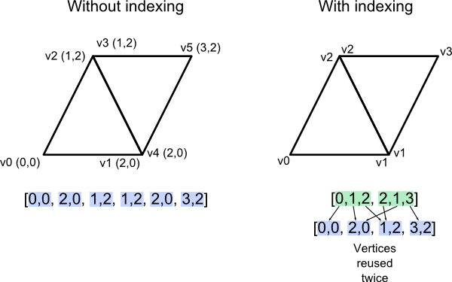
Indices
We’re going to use indices instead.
We reduce our vertex array so there are less verts to worry about but we introduce a new array called an index array.
The index array is where we specify what data make a specific triangle, by using a look up system to get the actual point data
This help use reduce the amount of data we have to send to the GPU or hold in memory.

Slide 13
How do we implement it?
See the tutorial

Slide 14
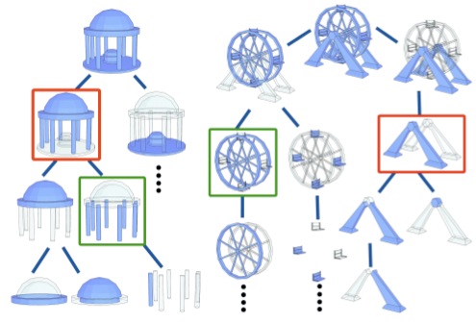
Models and Meshes
Up till now we have been working with a single mesh
But most 3d models we will be working with will have more than one mesh contained within it.
We use sub meshes to break complicated models into smaller chunks

Slide 15
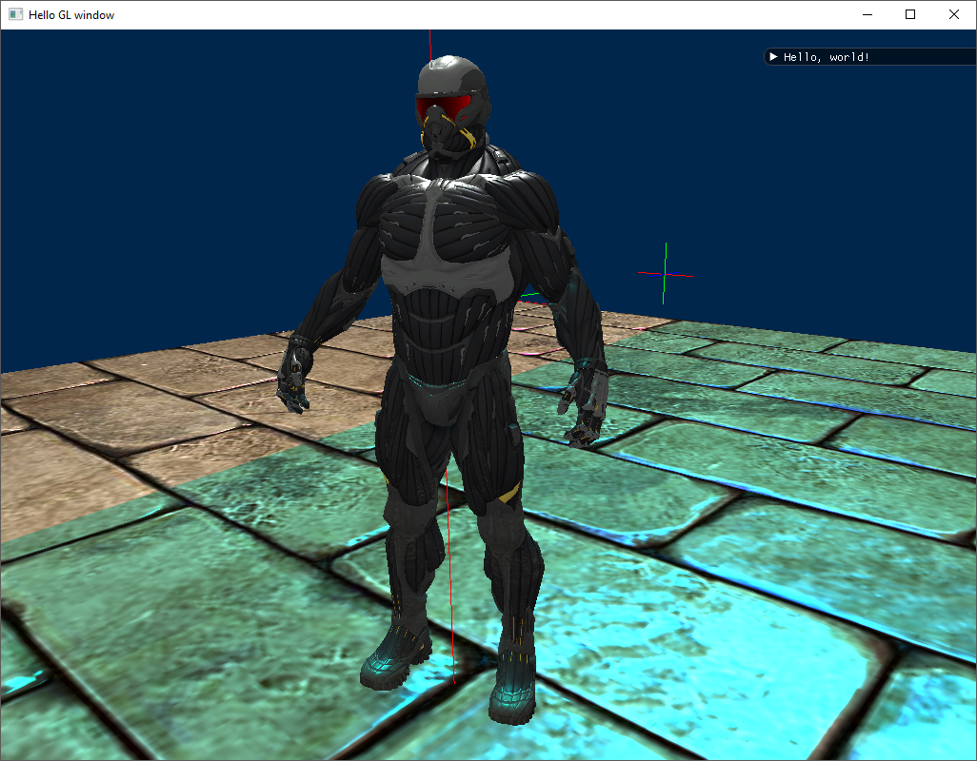
Event the Crysis 2 Nanosuit is made of separate meshes.
For instance, the legs are not part of the torso.
Each mesh can also have its own textures.
For this reason, its general a good idea to have separate meshes for each section to hold the mesh and texture data (we could use instancing but that’s beyond the scope of this class)
But keep all of these meshes as children within a bigger model object.

Slide 16
Questions?

